Slide 1
Support Vector Machine

Slide 2
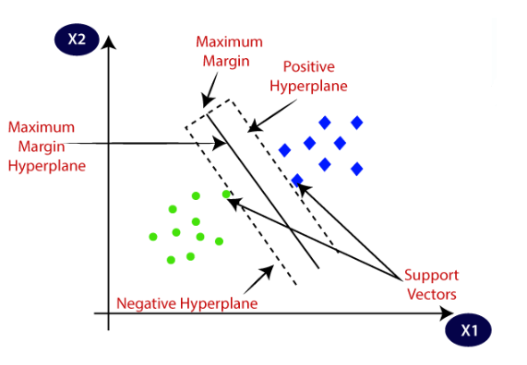
The goal of the SVM algorithm is to create the best line or plan that can segregate n-dimensional space into classes so that we can easily put the new data point in the correct category in the future. This best decision boundary is called a hyperplane.
The dimension of the hyperplane depends upon the number of features. If the number of input features is 2, then the hyperplane is just a line. If the number of input features is 3, then the hyperplane becomes a two-dimensional plane.
SVM chooses the extreme points/vectors that help in creating the hyperplane. These extreme cases are called support vectors, and hence algorithm is termed as Support Vector Machine.
Consider the below diagram in which there are two different categories that are classified using a decision boundary or hyperplane:

Slide 3
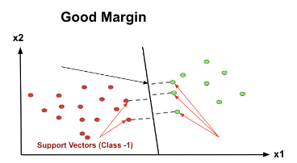
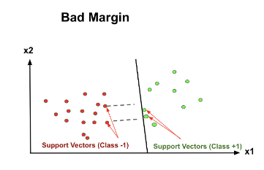
How can we decide a separating line or class is best for classification
The vector points closest to the hyperplane are known as the support vector points because only these two points are contributing to the result of the algorithm, and other points are not. If a data point is not a support vector, removing it has no effect on the model. On the other hand, deleting the support vectors will then change the position of the hyperplane.
The distance of the vectors from the hyperplane is called the margin, which is a separation of a line to the closest class points. We would like to choose a hyperplane that maximises the margin between classes.

Slide 4
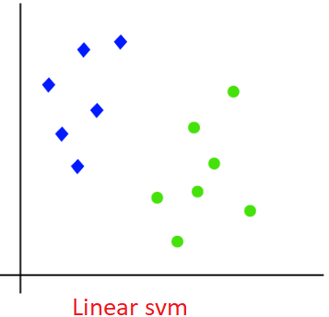
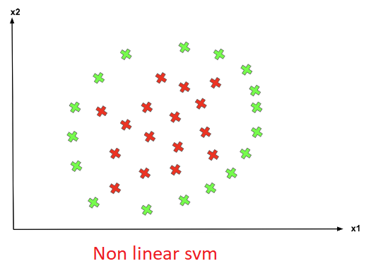
Types of SVM
Linear SVM: Linear SVM is used for linearly separable data, which means if a dataset can be classified into two classes by using a single straight line, then such data is termed as linearly separable data, and classifier is used called as Linear SVM classifier.
Non-linear SVM: Non-Linear SVM is used for non-linearly separated data, which means if a dataset cannot be classified by using a straight line, then such data is termed as non-linear data and classifier used is called as Non-linear SVM classifier.

Slide 5
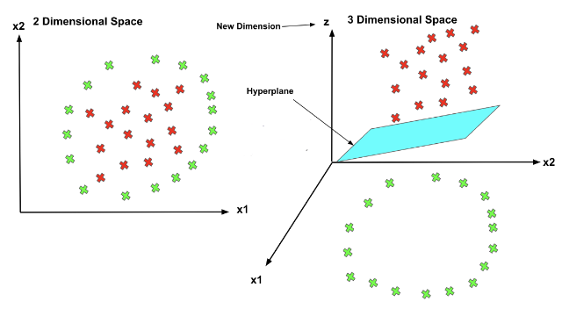
Non-Linear SVM:
SVM has a technique called the kernel trick. These are functions that take low dimensional input space and transform it into a higher-dimensional space, so by increasing dimension we can separate our class at higher dimension. That’s how non separable problem solved by non linear technique. It is mostly useful in non-linear separation problems. This is shown as follows:
Note:- rbf Kernels in SVM classification refer to the function that is responsible for defining the decision boundaries between the classes.

